Slide 1
Project 1: HFT and Cryptocurrency Trading Marker Discovery
Qiuan Wu, Xiaotian Zhu, Yuchen Wu

Slide 2
PCA and TSNE
PCA: The principal components of a collection of points in a real p-space are a sequence of p direction vectors, where the iᵗʰ vector is the direction of a line that best fits the data while being orthogonal to the first i-1 vectors. Here, a best-fitting line is defined as one that minimizes the average squared distance from the points to the line. These directions constitute an orthonormal basis in which different individual dimensions of the data are linearly uncorrelated. PCA is the process of computing the principal components and using them to perform a change of basis on the data, sometimes using only the first few principal components and ignoring the rest.V
TSNE is a nonlinear dimensionality reduction technique well-suited for embedding high-dimensional data for visualization in a low-dimensional space of two or three dimensions. Specifically, it models each high-dimensional object by a two- or three-dimensional point in such a way that similar objects are modeled by nearby points and dissimilar objects are modeled by distant points with high probability. it minimizes the Kullback–Leibler divergence (KL divergence) between the two distributions with respect to the locations of the points in the map. While the original algorithm uses the Euclidean distance between objects as the base of its similarity metric, this can be changed as appropriate.

Slide 3
UMAP and LLE
UMAP has a more robust theoretical foundation rooted in Riemannian manifold and tangent space theory, but it can be viewed as an optimized version of t-SNE. UMAP assumes data is uniformly distributed on a Riemannian manifold. UMAP employs different techniques to compute data similarity in the high-dimensional input space and low-dimensional embedding.
LLE: is a topology preserving manifold learning method. All manifold learning algorithms assume that dataset lies on a smooth non linear manifold of low dimension and a mapping f: RD -> Rd (D>>d) can be found by preserving one or more properties of the higher dimension space. Topology preservation means the neighborhood structure is intact. Unlike, distance preservation methods like MDS topology preservation is more intuitive. The points which are nearby in higher dimension should be close in lower dimension. The inspiration behind LLE is as original authors nicely put it 'Think globally fit locally'. Methods like SOM(self-organizing map) are also topology preserving but they assume a predefined lattice for the lower manifold. LLE creates the lattice based on the information contained in the dataset.

Slide 4
DBSCAN
It is a density-based clustering non-parametric algorithm: given a set of points in some space, it groups together points that are closely packed together (points with many nearby neighbors), marking as outliers points that lie alone in low-density regions (whose nearest neighbors are too far away). DBSCAN is one of the most common clustering algorithms and also most cited in scientific literature.
Algorithms start by picking a point(one record) x from your dataset at random and assign it to a cluster 1. Then it counts how many points are located within the ε (epsilon) distance from x. If this quantity is greater than or equal to minPoints (n), then considers it as core point, then it will pull out all these ε-neighbours to the same cluster 1. It will then examine each member of cluster 1 and find their respective ε -neighbours. If some member of cluster 1 has n or moreε-neighbours, it will expand cluster 1 by putting those ε-neighbours to the cluster. It will continue expanding cluster 1 until there are no more examples to put in it.
In the latter case, it will pick another point from the dataset not belonging to any cluster and put it to cluster 2. It will continue like this until all examples either belong to some cluster or are marked as outliers.

Slide 5
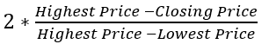
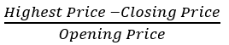
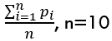
Features Added
Close of High =
Pesudo Violatility =
Moving Average =
Bolling Band:

Slide 6
High Frequency Trading
Threshold: 0.08%
Apple (AAPL)
American Eagle (AEO)
Bank of America (BAC)
Walmart (WMT)
Own data (10/20/2020 - 10/27/2020):
Google (GOOG)
Intel (INTC)
Ticker: | # of Traditional Markers
AAPL | 521
AEO | 1404
BAC | 715
WMT | 444
GOOG | 881
INTC | 740

Slide 7
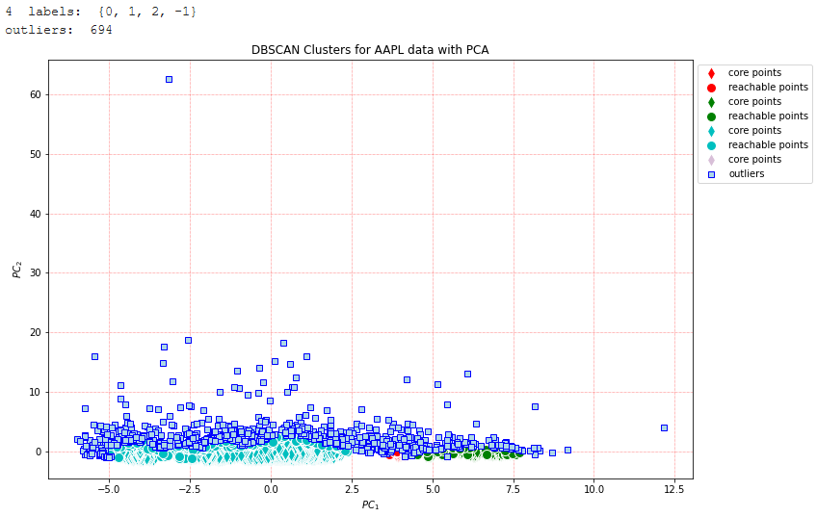
PCA - AAPL
EPS = 0.3
Min samples = 20

Slide 8
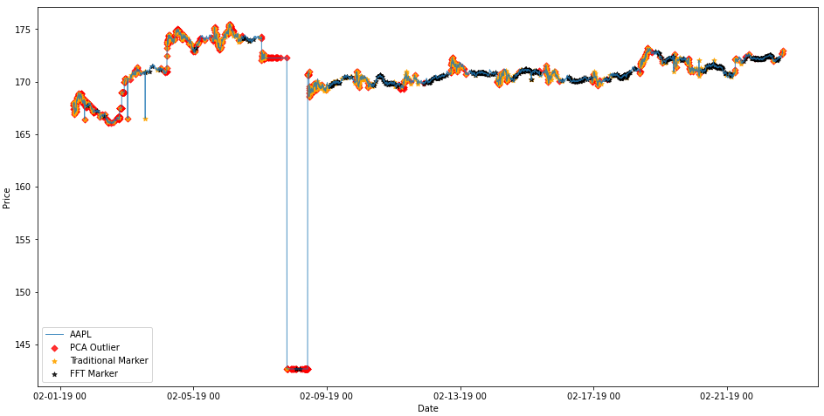
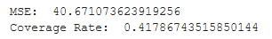
PCA - AAPL

Slide 9
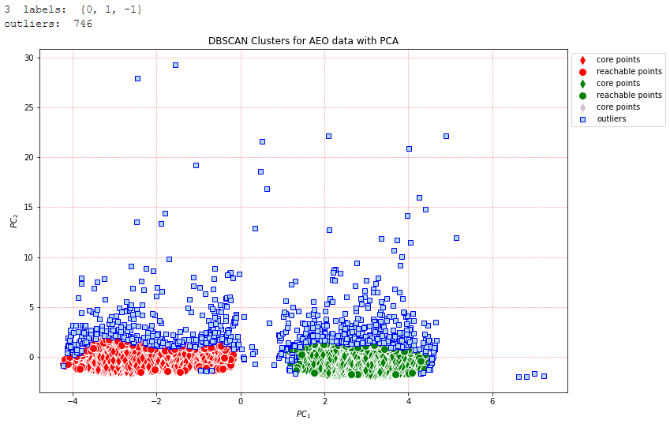
PCA - AEO
EPS = 0.3
Min samples = 30

Slide 10
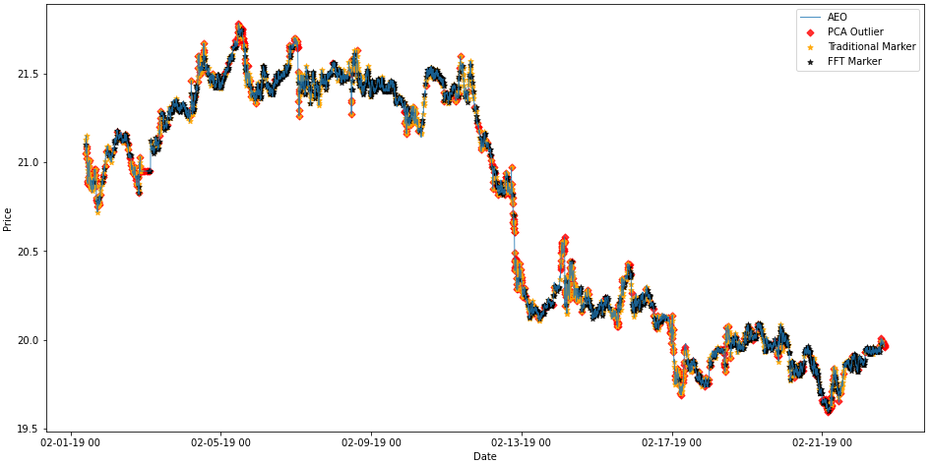
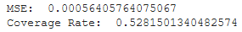
PCA - AEO

Slide 11
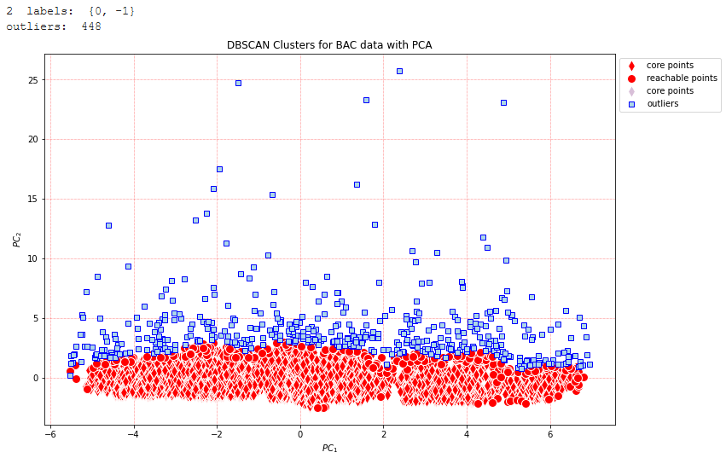
PCA - BAC
EPS = 0.5
Min samples = 30

Slide 12
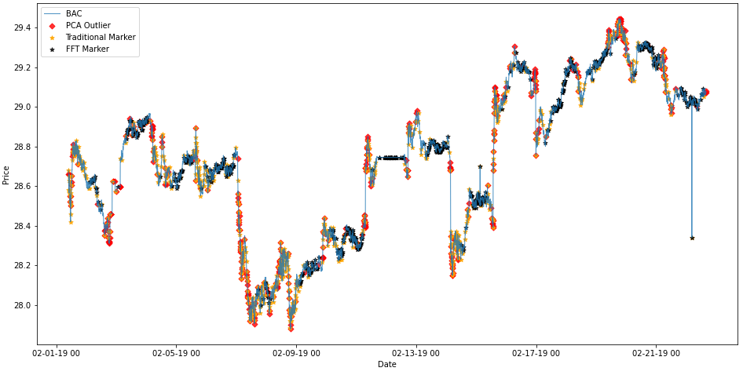
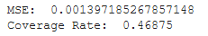
PCA - BAC

Slide 13
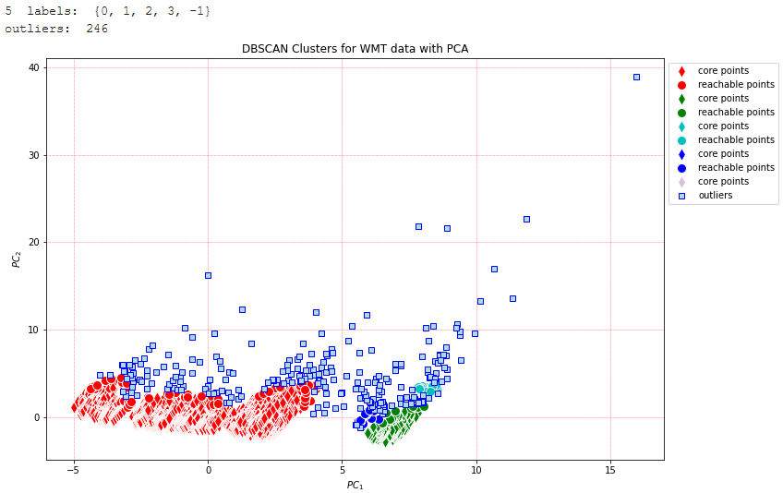
PCA - WMT
EPS = 0.5
Min samples = 15

Slide 14
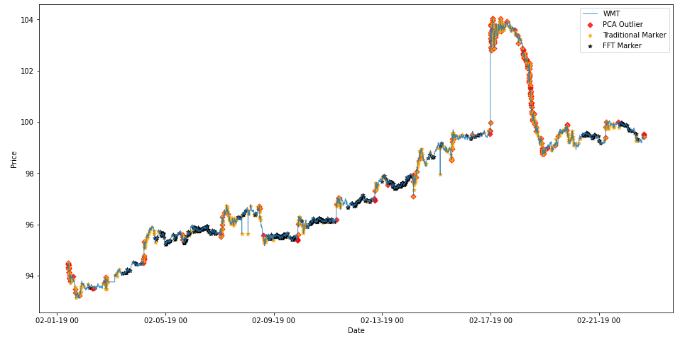
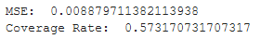
PCA - WMT

Slide 15
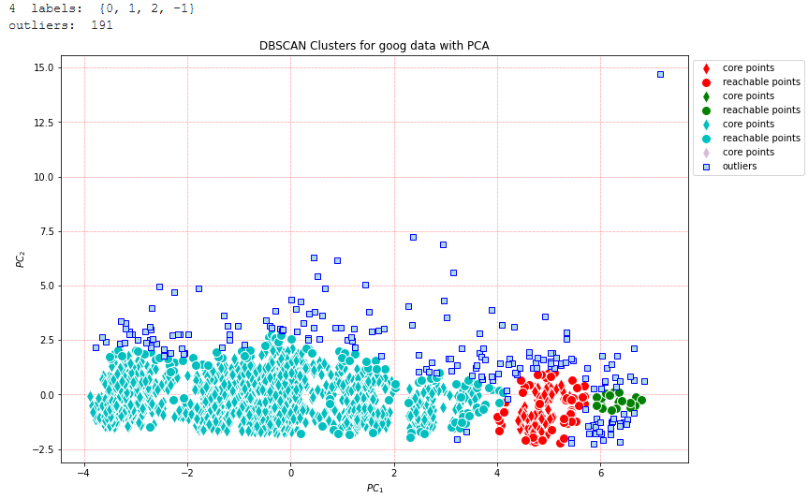
PCA - GOOG
EPS = 0.5
Min samples = 20

Slide 16
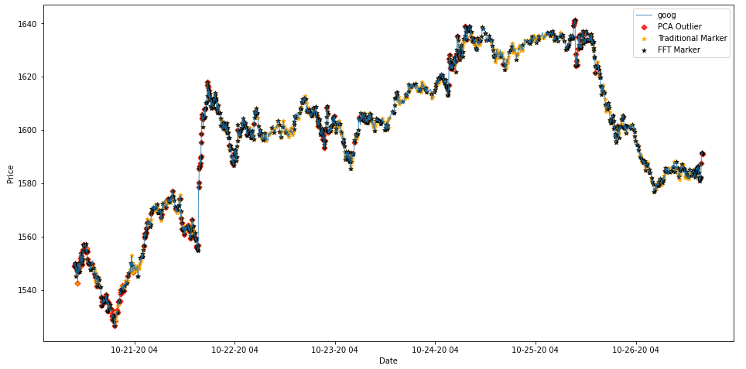
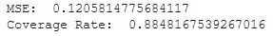
PCA - GOOG

Slide 17
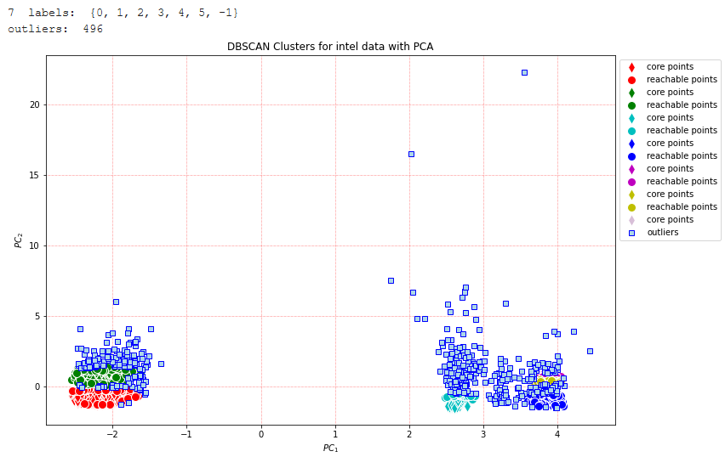
PCA - INTC
EPS = 0.2
Min samples = 40

Slide 18
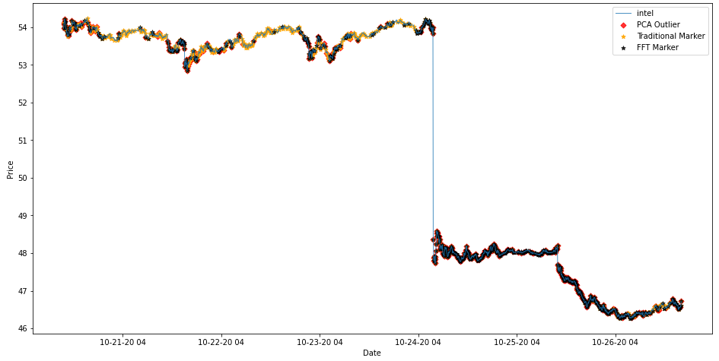
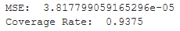
PCA - INTC

Slide 19
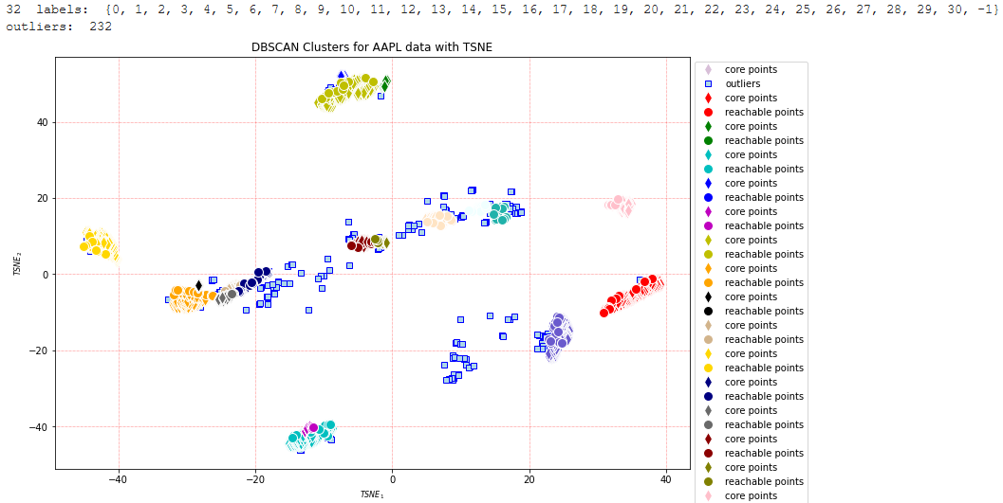
TSNE - AAPL
EPS = 0.8
Min samples = 12
Perplexity = 200

Slide 20
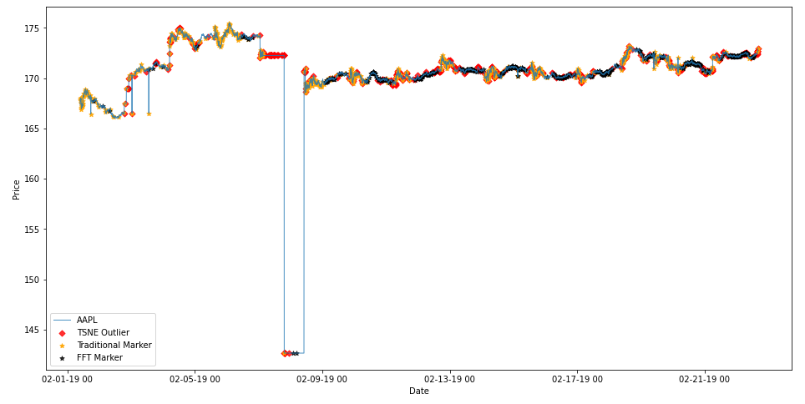
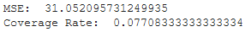
TSNE - AAPL

Slide 21
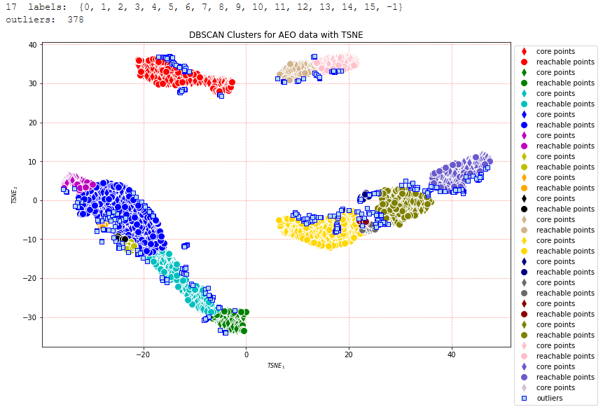
TSNE - AEO
EPS = 1
Min samples = 20
Perplexity = 200

Slide 22
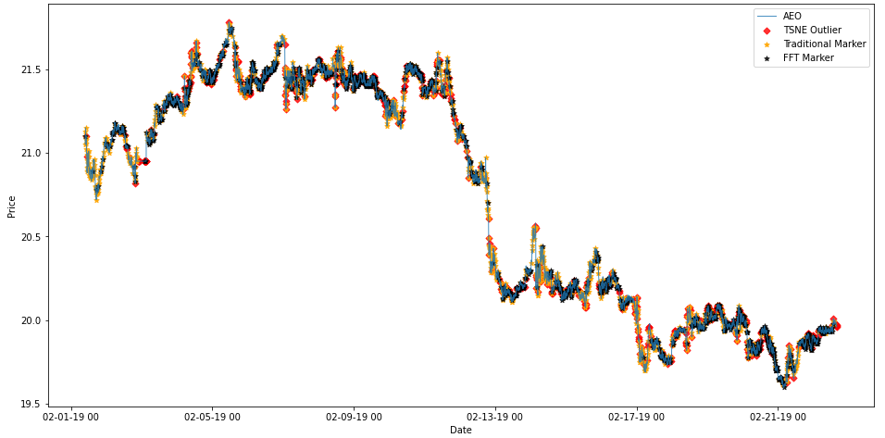
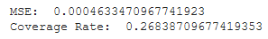
TSNE - AEO

Slide 23
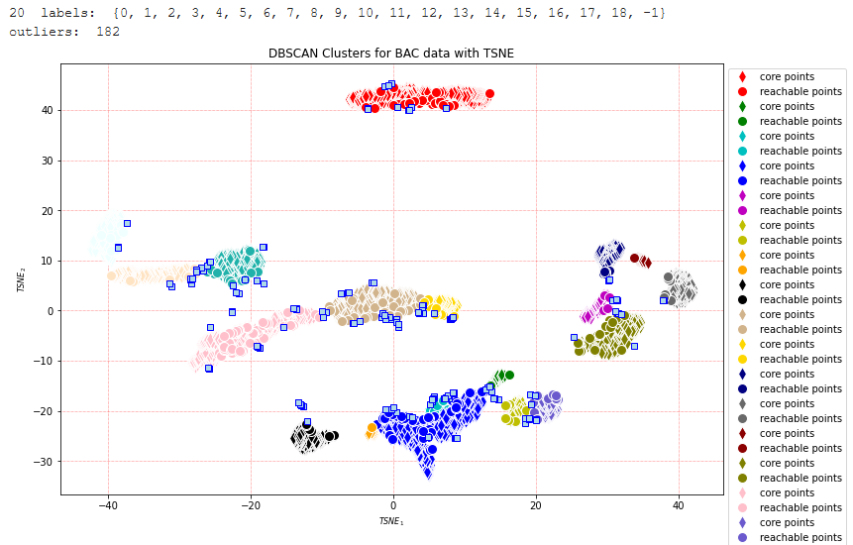
TSNE- BAC
EPS = 1
Min samples = 15
Perplexity = 200

Slide 24
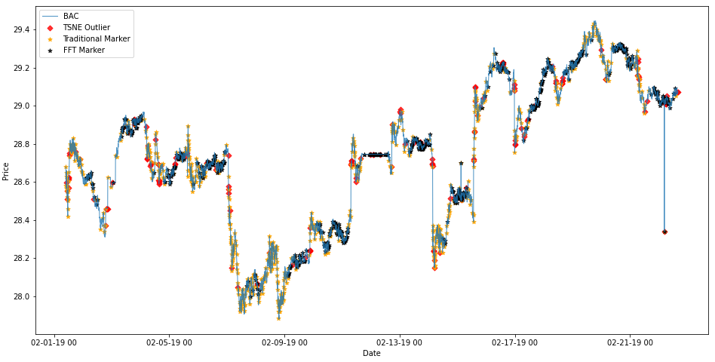
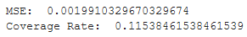
TSNE- BAC

Slide 25
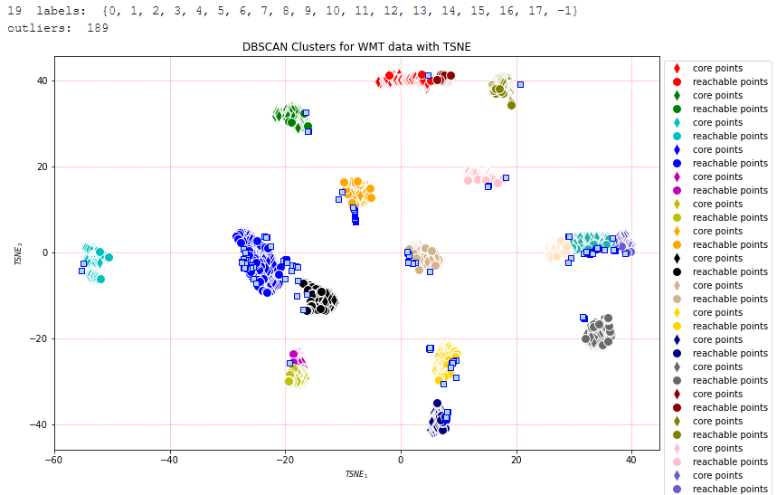
TSNE - WMT
EPS = 0.9
Min samples = 20
Perplexity = 200

Slide 26
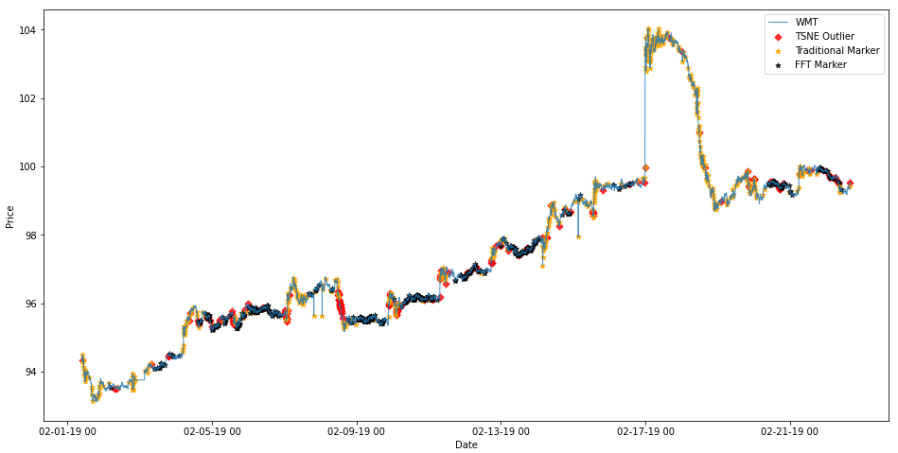
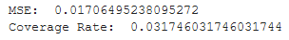
TSNE - WMT

Slide 27
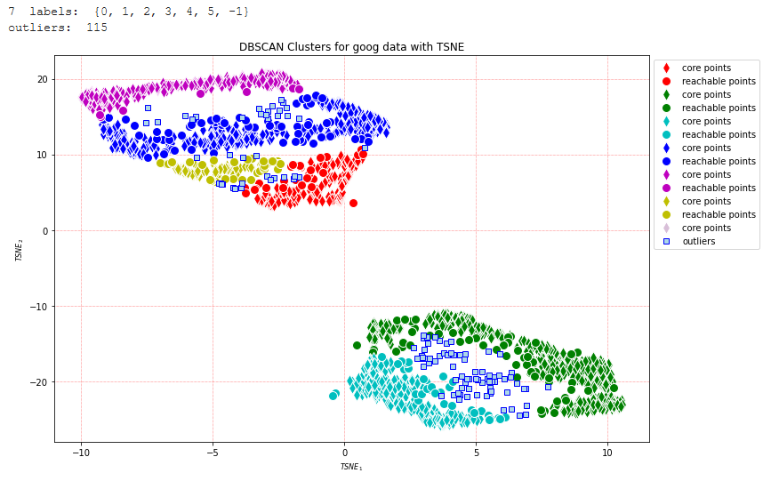
TSNE - GOOG
EPS = 1
Min samples = 20
Perplexity = 200

Slide 28
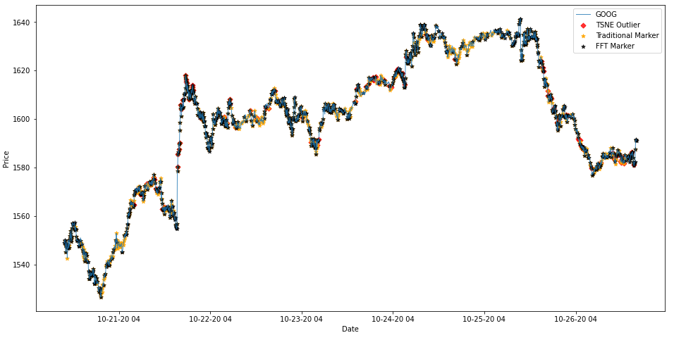
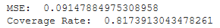
TSNE - GOOG

Slide 29
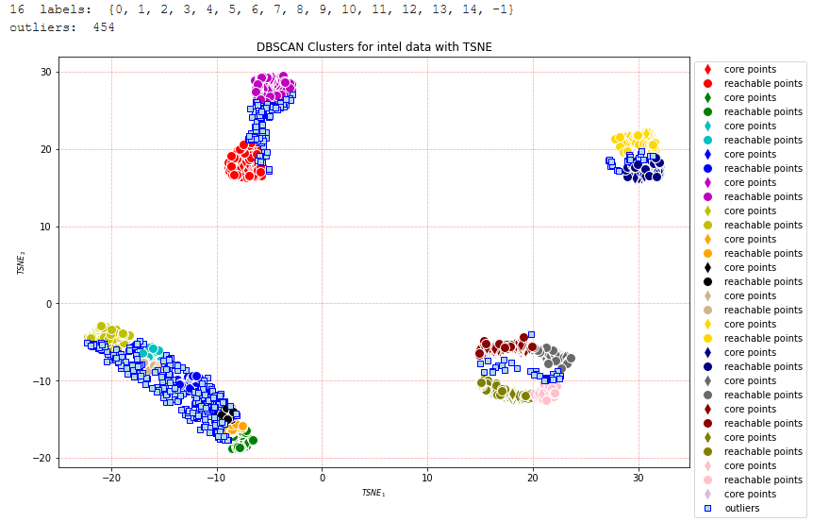
TSNE - INTC
EPS = 1
Min samples = 40
Perplexity = 150

Slide 30
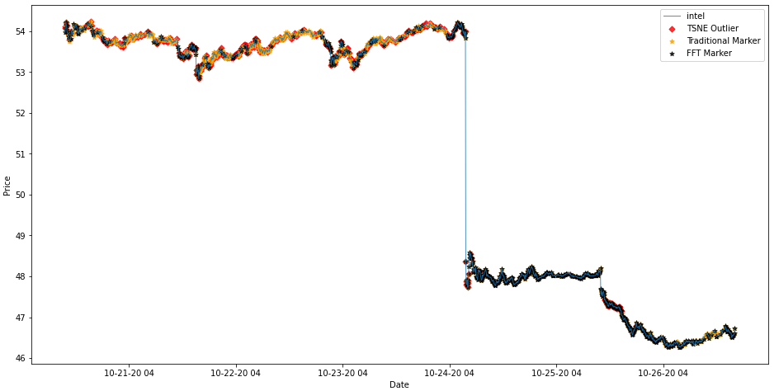
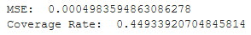
TSNE - INTC

Slide 31
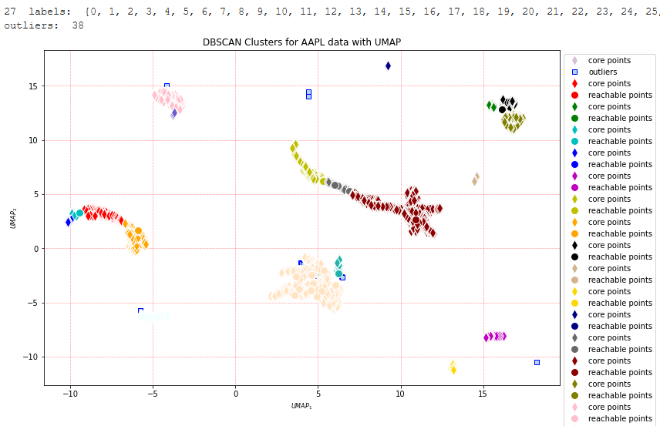
UMAP - AAPL
EPS = 0.3
Min samples = 10
Num neighbors = 10
Min distance = 0.3

Slide 32
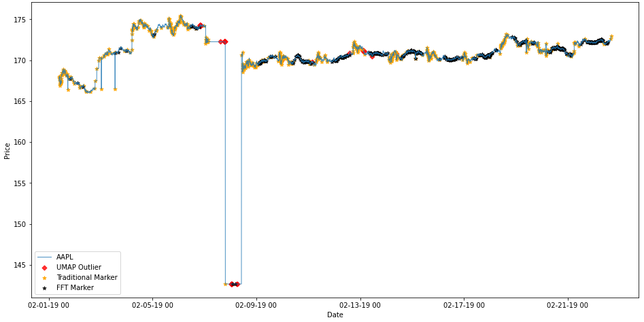
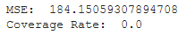
UMAP - AAPL

Slide 33
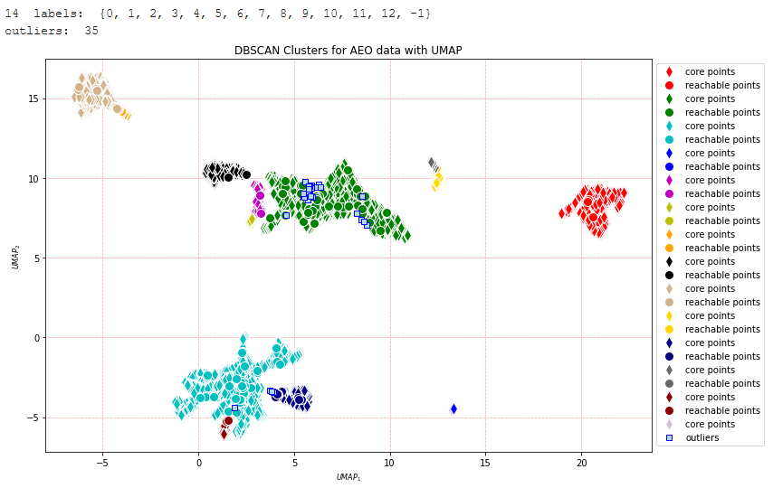
UMAP - AEO
EPS = 0.3
Min samples = 15
Num neighbors = 20
Min distance = 0.1

Slide 34
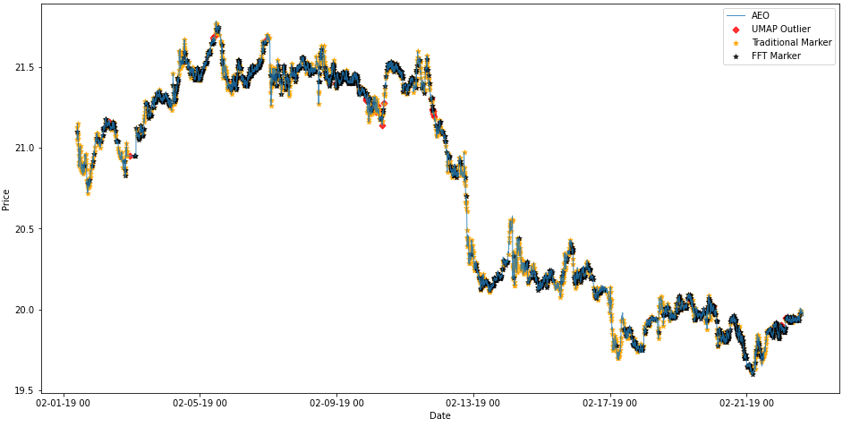
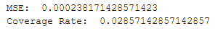
UMAP - AEO

Slide 35
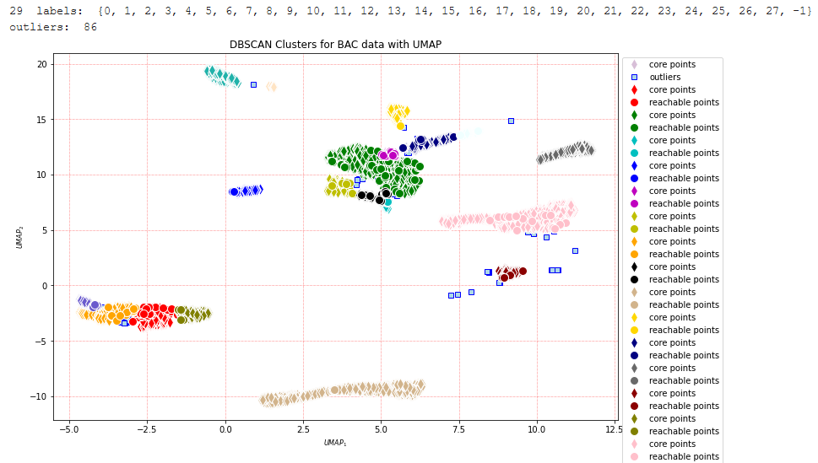
UMAP - BAC
EPS = 0.3
Min samples = 20
Num neighbors = 10
Min distance = 0.1

Slide 36
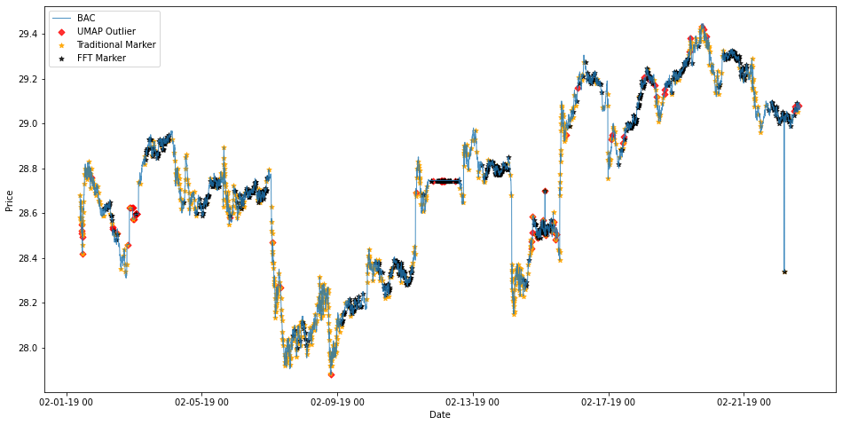
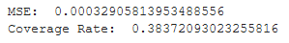
UMAP - BAC

Slide 37
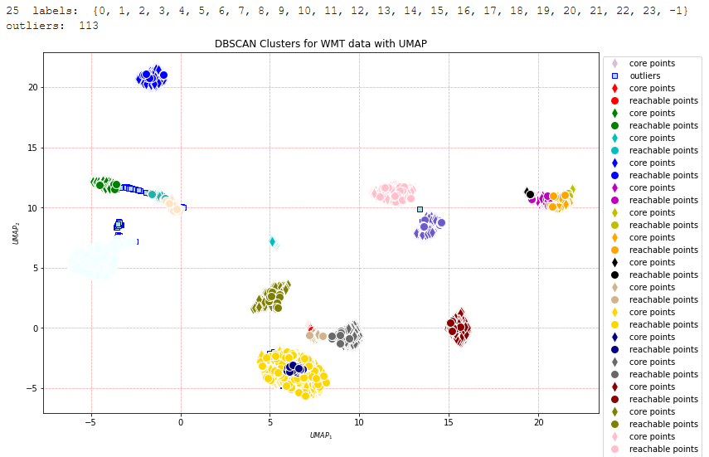
UMAP - WMT
EPS = 0.3
Min samples = 25
Num neighbors = 50
Min distance = 0.1

Slide 38
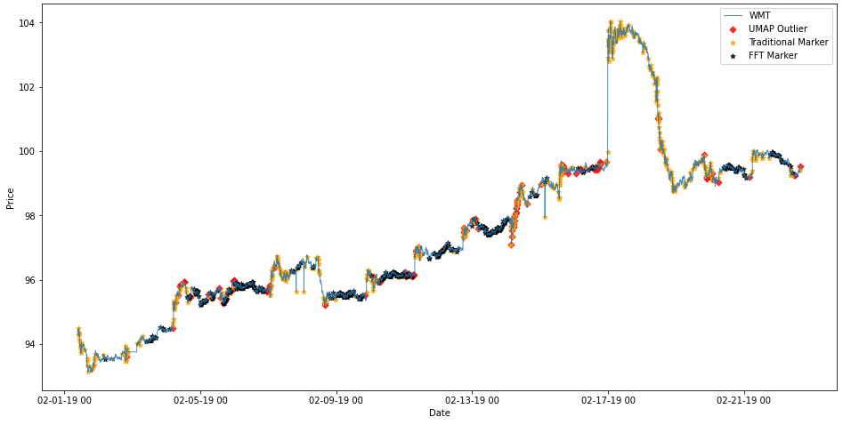

UMAP - WMT

Slide 39

UMAP - GOOG
EPS = 0.4
Min samples = 25
Num neighbors = 10
Min distance = 0.5

Slide 40


UMAP - GOOG

Slide 41

UMAP - INTC
EPS = 0.4
Min samples = 30
Num neighbors = 10
Min distance = 0.5

Slide 42


UMAP - INTC

Slide 43

LLE - AAPL
EPS = 0.001
Min samples = 20
Num neighbors = 100

Slide 44


LLE - AAPL

Slide 45

LLE - AEO
EPS = 0.001
Min samples = 10
Num neighbors = 100

Slide 46


LLE - AEO

Slide 47

LLE - BAC
EPS = 0.002
Min samples = 10
Num neighbors = 100

Slide 48


LLE - BAC

Slide 49

LLE - WMT
EPS = 0.005
Min samples = 25
Num neighbors = 100

Slide 50


LLE - WMT

Slide 51

LLE - GOOG
EPS = 0.006
Min samples = 20
Num neighbors = 100

Slide 52


LLE - GOOG

Slide 53

LLE - INTC
EPS = 0.0005
Min samples = 30
Num neighbors = 100

Slide 54


LLE - INTC

Slide 55
Summary of Dimension Reduction for HFT
Mean Squared Error:
 | AAPL | AEO | BAC | WMT | GOOG | INTC
PCA | 40.7 | 0.0006 | 0.0014 | 0.0089 | 0.1206 | 0.00004
TSNE | 31.1 | 0.0005 | 0.0019 | 0.017 | 0.0915 | 0.0005
UMAP | 184.2 | 0.0002 | 0.0003 | 0.009 | 0.077 | 0.0003
LLE | 5.5 | 0.0007 | 0.0009 | 0.0116 | 0.0833 | 0.0000006
Coverage Rate:
 | AAPL | AEO | BAC | WMT | GOOG | INTC
PCA | 42% | 53% | 47% | 57% | 89% | 94%
TSNE | 8% | 3% | 11% | 4% | 82% | 45%
UMAP | 0% | 3% | 38% | 35% | 88% | 59%
LLE | 58% | 52% | 36% | 23% | 73% | 97%

Slide 56
Cryptocurrency
Since the ETHUSD data has 100000+ observations, we decided to split the data into 4 parts and do dimension reduction separately.
Threshold: 0.5%
crypt_df_lst =
[crypt_df.iloc[:36000],
Crypt_df.iloc[36001:72000],
crypt_df.iloc[72001:104000],
crypt_df.iloc[104001:]]
Part | # of Traditional Markers
1 | 2584
2 | 2021
3 | 2269
4 | 1052

Slide 57

PCA - ETHUSD_1
EPS = 0.3
Min samples = 10

Slide 58


PCA - ETHUSD_1

Slide 59

PCA - ETHUSD_2
EPS = 0.3
Min samples = 10

Slide 60


PCA - ETHUSD_2

Slide 61

PCA - ETHUSD_3
EPS = 0.3
Min samples = 10

Slide 62


PCA - ETHUSD_3

Slide 63

PCA - ETHUSD_4
EPS = 0.3
Min samples = 10

Slide 64


PCA - ETHUSD_4

Slide 65

TSNE - ETHUSD_1
EPS = 0.9
Min samples = 10
Perplexity = 200

Slide 66


TSNE - ETHUSD_1

Slide 67

TSNE - ETHUSD_2
EPS = 0.9
Min samples = 10
Perplexity = 200

Slide 68


TSNE - ETHUSD_2

Slide 69

TSNE - ETHUSD_3
EPS = 0.9
Min samples = 10
Perplexity = 200

Slide 70


TSNE - ETHUSD_3

Slide 71

TSNE - ETHUSD_4
EPS = 0.9
Min samples = 10
Perplexity = 200

Slide 72


TSNE - ETHUSD_4

Slide 73

UMAP- ETHUSD_1
43 labels: {0, 1, 2, 3, 4, 5, 6, 7, 8, 9, 10, 11, 12, 13, 14, 15, 16, 17, 18, 19, 20, 21, 22, 23, 24, 25, 26, 27, 28, 29, 30, 31, 32, 33, 34, 35, 36, 37, 38, 39, 40, 41, -1}
outliers: 118
EPS = 0.15
Min samples = 10
Num neighbors = 100
Min distance = 0.3

Slide 74


UMAP- ETHUSD_1

Slide 75

UMAP- ETHUSD_2
EPS = 0.15
Min samples = 10
Num neighbors = 100
Min distance = 0.3

Slide 76


UMAP- ETHUSD_2

Slide 77

UMAP- ETHUSD_3
EPS = 0.15
Min samples = 10
Num neighbors = 100
Min distance = 0.3

Slide 78


UMAP- ETHUSD_3

Slide 79

UMAP- ETHUSD_4
EPS = 0.15
Min samples = 10
Num neighbors = 100
Min distance = 0.3

Slide 80


UMAP- ETHUSD_4

Slide 81

LLE - ETHUSD_1
EPS = 0.0005
Min samples = 10
Num neighbors = 50

Slide 82



LLE - ETHUSD_1

Slide 83

LLE - ETHUSD_2
EPS = 0.0005
Min samples = 10
Num neighbors = 50

Slide 84


LLE- ETHUSD_2

Slide 85

LLE - ETHUSD_3
EPS = 0.0005
Min samples = 10
Num neighbors = 50

Slide 86


LLE- ETHUSD_3

Slide 87

LLE - ETHUSD_4
EPS = 0.0005
Min samples = 10
Num neighbors = 50

Slide 88


LLE - ETHUSD_4

Slide 89
Summary of Dimension Reduction for Cryptocurrency
Mean Squared Error:
 | ETHUSD_1 | ETHUSD_2 | ETHUSD_3 | ETHUSD_4
PCA | 0.81 | 0.01 | 0.09 | 0.36
TSNE | 4.33 | 0.69 | 2.04 | 0.91
UMAP | 2.04 | 0.89 | 3.21 | 0.56
LLE | 10.49 | 4.10 | 0.95 | 2.29
Coverage Rate:
 | ETHUSD_1 | ETHUSD_2 | ETHUSD_3 | ETHUSD_4
PCA | 98% | 98% | 96% | 89%
TSNE | 13% | 13% | 19% | 9%
UMAP | 20% | 4% | 13% | 0%
LLE | 19% | 15% | 47% | 1%

Slide 90
Conclusion
In general, PCA is the best dimension reduction method since it shows the biggest coverage rate in most of the cases of HFT data . In fact, the power of PCA can be seen more clearly from the result of cryptocurrency data because the numbers are so close to 100% while the others can hardly exceed 50%. LLE also performs fairly well in some cases like INTC and AAPL. TSNE has the worst performance because the coverage rate is always the lowest.
The difference in HFT dataset maybe caused by its industry and its trading frequency.
The cryptocurrency is a relative new thing that only some governments accept it and there is almost none regulation to its trading market. So cryptocurrency can be very volatile which makes it so different from HFT market.

Slide 91
Thank You!

